Slide 1
Overview of FAA’s Southern California Metroplex Project
Paul Dunholter, P.E.
Jim Allerdice
July 23, 2015

Slide 2
NextGen
Safely improve the efficiency of the
National Airspace System (NAS) by
improving efficiencies at metropolitan
areas with complex air traffic flows
using integrated solutions.¹
¹ FAA Presentation on 6/22/2015 OAPM SoCal Metroplex
Click image to see video

Slide 3
Benefits of Metroplex Projects
Metroplex projects provide benefits to Air
Traffic Control (ATC) by providing more
options for routing aircraft to increase
airspace and airport efficiency.
The project benefits the traveling public by
reducing delays and enhancing safety.
Metroplex procedures benefit the airlines
by reducing fuel burn and emissions.

Slide 4
What is the Metroplex?
The Southern California Metroplex reviews all airspace procedures at 21 metropolitan airports to determine how new satellite procedures can be best utilized.
Sponsor
This is the FAA’s project. The Airport Authority has not been involved in identifying or evaluating changes to flight procedures.
Purpose
The goal of the Metroplex project is to optimize air traffic procedures and airspace by upgrading from ground-based navigation systems to satellite-based systems.
Metroplex
A “Metroplex” is a geographical area covering several airports serving metropolitan areas such as Southern California.
Comprehensive
Historically, satellite procedures were developed one procedure at a time at each individual airport. Metroplex projects are a comprehensive and strategic approach.

Slide 5
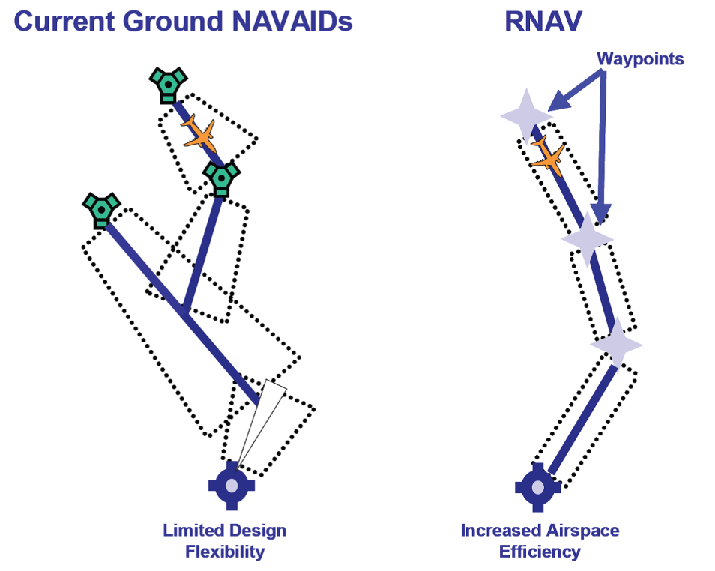
Ground versus Satellite Navigation
Ground-based navigation requires point-to-point communication and routing.
Satellite-based navigation Procedures provide efficient and direct routes for aircraft to reach their destinations.
Click image
to see video
Source: Federal Aviation Administration

Slide 6
Metroplex Facts
Satellite procedures have been utilized at SDIA for almost eight years.
Residents under the concentrated flight path may experience more noise.
New procedures may include changes in flight paths and/or altitudes in certain areas.
Changes in flight paths may result in exposing new areas to aircraft overflights.
The FAA is conducting an Environment Assessment (EA) on all Southern California Procedures.
New procedures will create more precise and narrower flight paths.

Slide 7
Review of Metroplex Departures West
Western Departures
Changes to the departure procedures call for aircraft to make a tighter turn and bring all planes closer to the Point Loma Peninsula than they do today.
= Departing flight tracks today
= Satellite-based flight procedure corridor for arrivals
Note: No new Metroplex procedures create noise impacts within the 65 dB CNEL. It may increase Single Event Noise levels in certain areas.

Slide 8
Review of Metroplex Arrivals East
Eastern Arrivals
Location of navigation points for aircraft arriving into San Diego have slight changes that could alter flight paths.
The flight corridor that was once dispersed will ultimately (after many years) be concentrated into a narrow and precise corridor.
= Arriving flight tracks today
= Satellite-based flight procedure corridor for arrivals
Note: No new Metroplex procedures create noise impacts within the 65 dB CNEL. It may increase Single Event Noise levels in certain areas.

Slide 9
Staff Action Items
Airport Staff and Consultants are currently reviewing the technical aspects of the proposed SoCal Metroplex Procedures.
Review
Technical Response
Coordinate with FAA
Technical Response
A response is being prepared that will identify specific noise abatement goals and issues that we would like the FAA Metroplex Team to consider in their design.
Coordination with FAA
As much as it is feasible, staff will coordinate with the FAA to implement any of the measures in our technical response.
Public comment on the FAA’s EA has been extended until September 8, 2015.
Information to Public
The FAA has a website with all documentation, which is updated as new information becomes available.

Slide 10
Questions

